Slide 1
17
File Processing

Slide 2
I read part of it all the way through.
  Samuel Goldwyn
I can only assume that a “Do Not File” document is filed in a “Do Not File” file.
  Senator Frank Church
  Senate Intelligence Subcommittee Hearing, 1975
A great memory does not make a philosopher,
any more than a dictionary can be called grammar.
  John Henry, Cardinal Newman

Slide 3
OBJECTIVES
In this chapter you’ll learn:
To create, read, write and update files.
Sequential file processing.
Random-access file processing.
To use high-performance unformatted I/O operations.
The differences between formatted-data and raw-data file processing.
To build a transaction-processing program using random-access file processing.

Slide 4
17.1 Introduction
17.2 The Data Hierarchy
17.3 Files and Streams
17.4 Creating a Sequential File
17.5 Reading Data from a Sequential File
17.6 Updating Sequential Files
17.7 Random-Access Files
17.8 Creating a Random-Access File
17.9 Writing Data Randomly to a Random-Access File
17.10 Reading from a Random-Access File Sequentially
17.11 Case Study: A Transaction-Processing Program
17.12 Overview of Object Serialization
17.13 Wrap-Up

Slide 5
17.1 Introduction
Files
  Used for data persistence
    Permanent retention of large amounts of data
  Stored on secondary storage devices
    Magnetic disks
    Optical disks
    Tapes

Slide 6
17.2 The Data Hierarchy
Bits (“binary digits”)
  Can assume one of two values, 0 or 1
  Smallest data item that computers support
    Computer circuitry performs simple bit manipulations
    Ultimately all data items are composed of bits
Characters
  Include decimal digits, letters and special symbols
    Composed of bits (1s and 0s)
  A character set is the set of all characters used on a particular computer
  chars are stored in bytes (8 bits)
  wchar_ts are stored in more than one byte

Slide 7
17.2 The Data Hierarchy (Cont.)
Fields
  Composed of characters
  Conveys some meaning
  Example
    Uppercase and lowercase letters can represent a name
Records
  Composed of several fields
  Represented as a class in C++
  Example
    An employee’s record might include id#, name, address, etc.
  A record key is a field unique to each record

Slide 8
17.2 The Data Hierarchy (Cont.)
File
  Composed of a group of related records
  Example
    A payroll file containing one record for each employee
  Many ways to organize records in a file
    Such as a sequential file
      Records are stored in order by a record-key field
Database
  Composed of a group of related files
  Managed by a collection of programs called a database management system (DBMS)

Slide 9
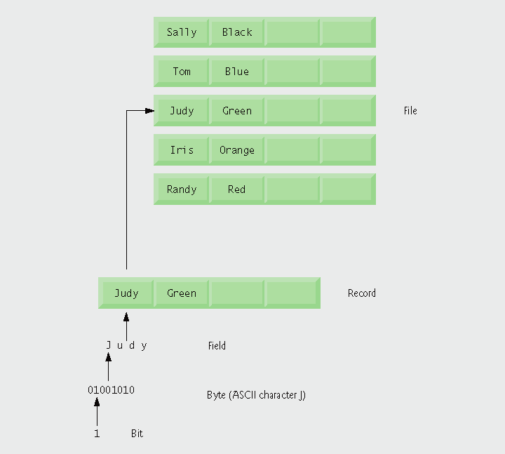
Fig. 17.1 | Data hierarchy.

Slide 10
17.3 Files and Streams
Files
  Viewed by C++ as a sequence of bytes
  Ends either with an end-of-file marker or at a system-recorded byte number
  Communication between a program and a file is performed through stream objects
    <fstream> header file
      Stream class templates
        basic_ifstream – for file input
        basic_ofstream – for file output
        basic_fstream – for file input and output
      Files are opened by creating objects of stream template specializations

Slide 11

Fig. 17.2 | C++’s view of a file of n bytes.

Slide 12
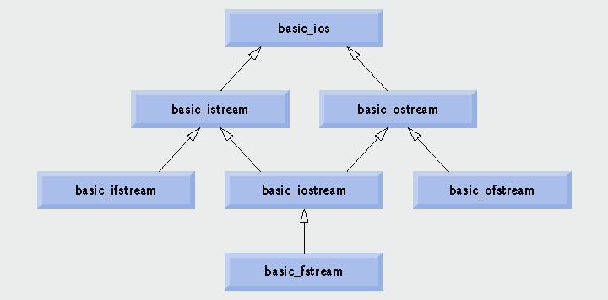
Fig. 17.3 | Portion of stream I/O template hierarchy.

Slide 13
17.4 Creating a Sequential File
File structure
  The programmer must structure files
    C++ does not impose structures on files

Slide 14
17.4 Creating a Sequential File (Cont.)
Creating an ofstream object
  Opens a file for output
  Constructor takes two arguments
    A filename
      If the file doe not exist, it is first created
    A file-open mode
      ios::out – the default mode
        Overwrites preexisting data in the file
      ios::app
        Appends data to the end of the file
  Can also use member function open on existing object
    Takes same arguments as the constructor

Slide 15
17.4 Creating a Sequential File (Cont.)
Using an ofstream object
  Writing to the file
    Use the stream insertion operator
  Member function close
    Releases the file resource
    Implicitly performed by ofstream’s destructor
ios operators (usable with ofstream)
  Operator member function operator!
    Returns true if either the failbit or badbit is set
  Operator member function operator void *
    Converts the stream to a pointer
      The null pointer if either the failbit or badbit is set

Slide 16
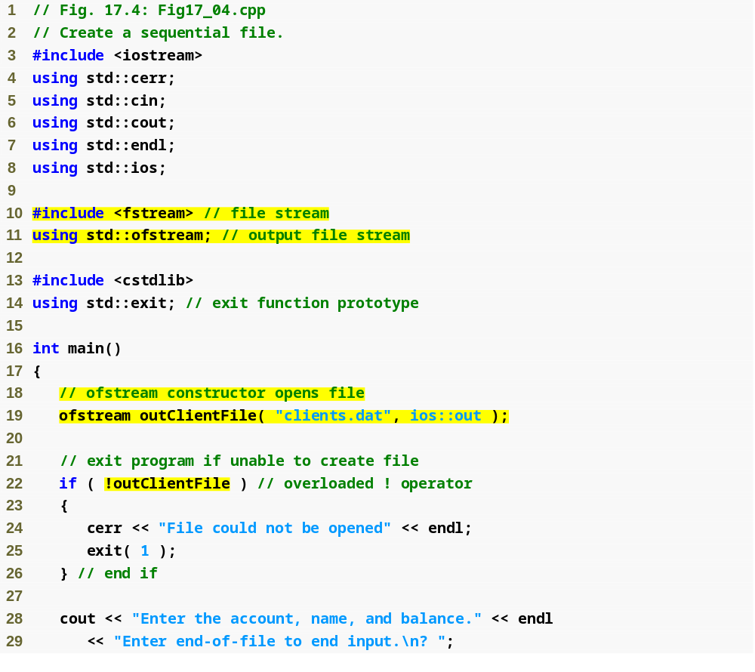
Outline
Fig17_04.cpp
(1 of 2)
Open file client.dat for output
Overloaded operator! will return true if the file did not open successfully

Slide 17
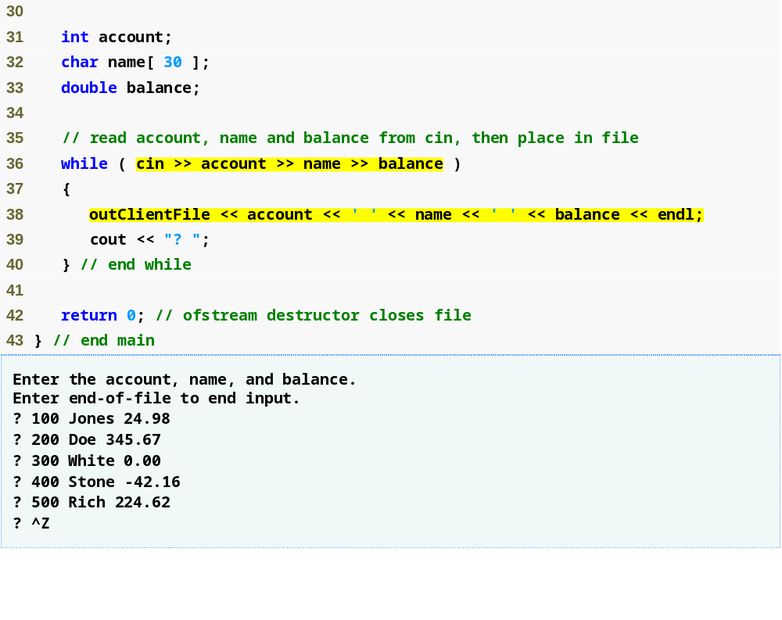
Outline
Overloaded operator void * will return the null pointer 0 (false) when the user enters the end-of-file indicator
Fig17_04.cpp
(2 of 2)
Write data to client.dat using the stream insertion operator
ofstream destructor implicitly closes the file

Slide 18
Common Programming Error 17.1
Use caution when opening an existing file for output (ios::out), especially when you want to preserve the file’s contents, which will be discarded without warning.

Slide 19
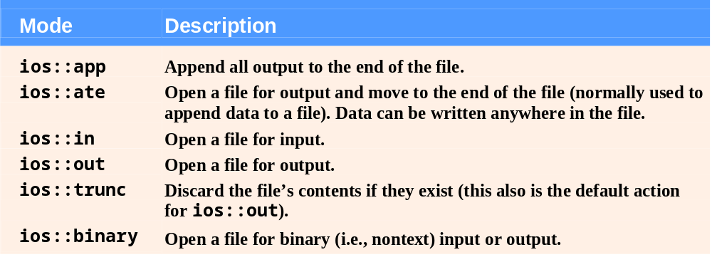
Fig. 17.5 | File open modes.

Slide 20
Common Programming Error 17.2
Not opening a file before attempting to reference it in a program will result in an error.

Slide 21
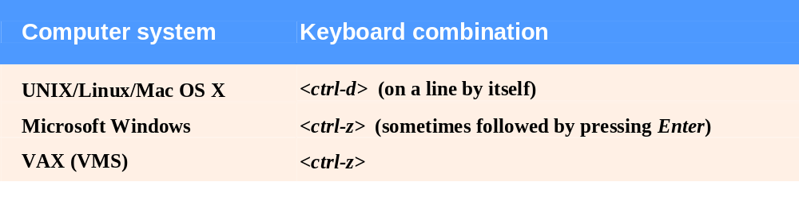
Fig. 17.6 | End-of-file key combinations for various popular computer systems.

Slide 22
Performance Tip 17.1
Closing files explicitly when the program no longer needs to reference them can reduce resource usage (especially if the program continues execution after closing the files).

Slide 23
17.5 Reading Data from a Sequential File
Creating an ifstream object
  Opens a file for input
  Constructor takes two arguments
    A filename
    A file-open mode
      ios::in – the default mode
        Can only read from the file
  Can also use member function open on an existing object
    Takes same arguments as the constructor

Slide 24
Good Programming Practice 17.1
Open a file for input only (using ios::in) if the file’s contents should not be modified. This prevents unintentional modification of the file’s contents and is an example of the principle of least privilege.

Slide 25
17.5 Reading Data from a Sequential File (Cont.)
File-position pointer
  The byte number of the next byte to be read or written
  Member functions seekg and seekp (of istream and ostream, respectively)
    Repositions the file-position pointer to the specified location
      Takes desired offset argument as a long
    A second argument can specify the seek direction
      ios::beg – the default
        Positioning relative to the beginning
      ios::cur
        Positioning relative to the current position
      ios::end
        Positioning relative to the end

Slide 26
17.5 Reading Data from a Sequential File (Cont.)
  Member functions seekg and seekp (Cont.)
    Examples
      fileObject.seekg( n );
        Position to the nth byte of fileObject
      fileObject.seekg( n, ios::cur );
        Position n bytes forward in fileobject
      fileObject.seekg( n, ios::end );
        Position n bytes back from end of fileObject
      fileObject.seekg( 0, ios::end );
        Position at end of fileObject

Slide 27
17.5 Reading Data from a Sequential File (Cont.)
File-position pointer (Cont.)
  Member functions tellg and tellp (of istream and ostream, respectively)
    Returns current position of the file-position pointer as type long
    Example
      location = fileObject.tellg();

Slide 28
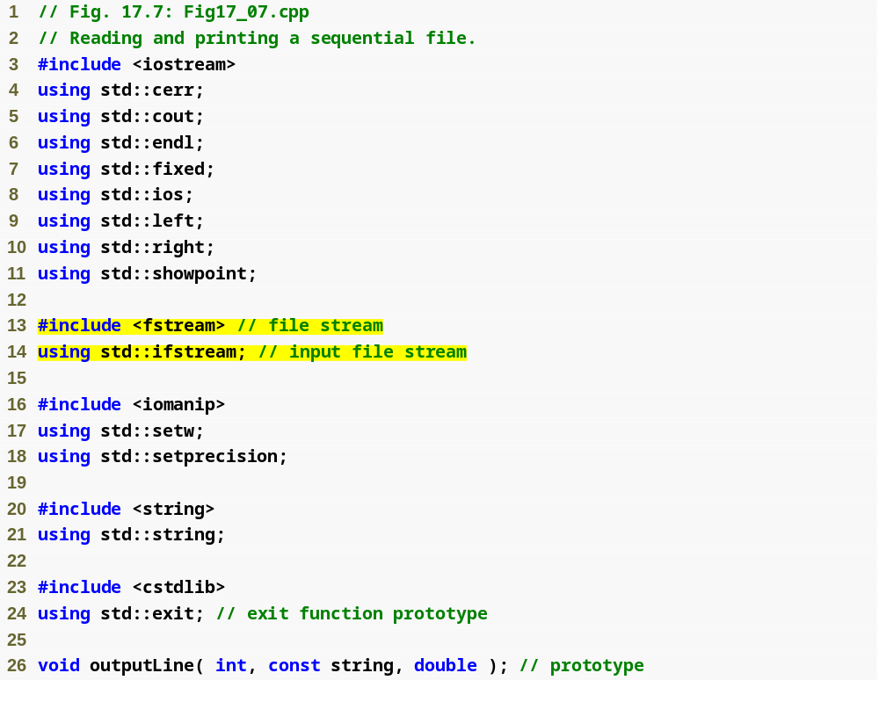
Outline
Fig17_07.cpp
(1 of 3)

Slide 29
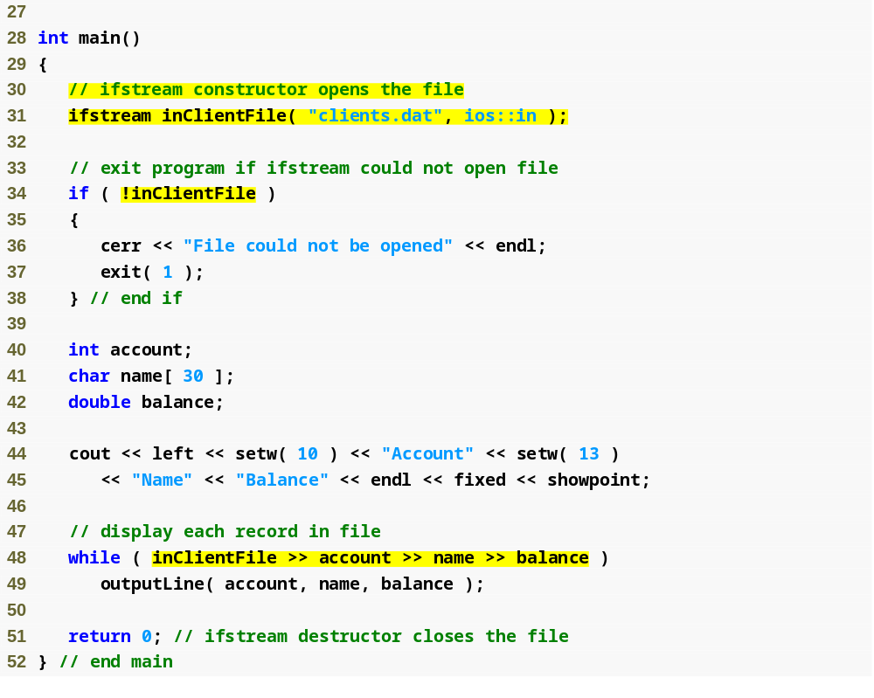
Outline
Open clients.dat for input
Fig17_07.cpp
(2 of 3)
Overloaded operator! returns true if clients.dat was not opened successfully
Overloaded operator void * returns a null pointer 0 (false) when the end of clients.dat is reached
ifstream destructor implicitly closes the file

Slide 30
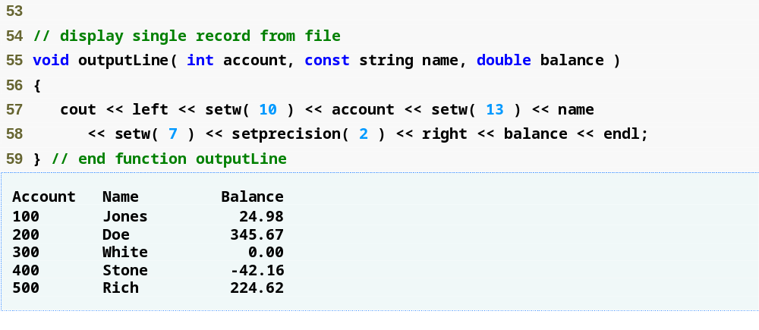
Outline
Fig17_07.cpp
(3 of 3)

Slide 31
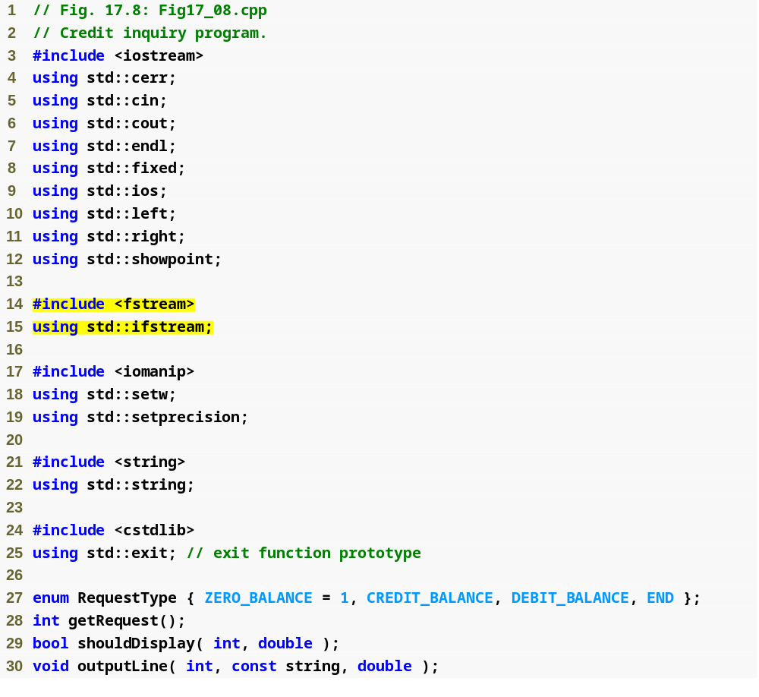
Outline
Fig17_08.cpp
(1 of 6)

Slide 32
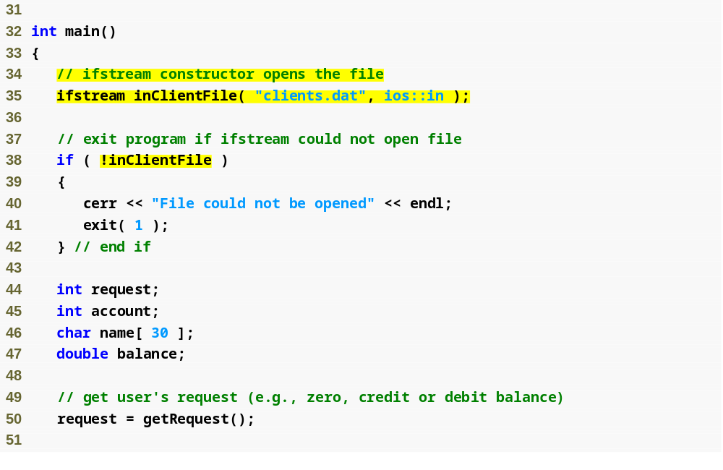
Outline
Fig17_08.cpp
(2 of 6)

Slide 33
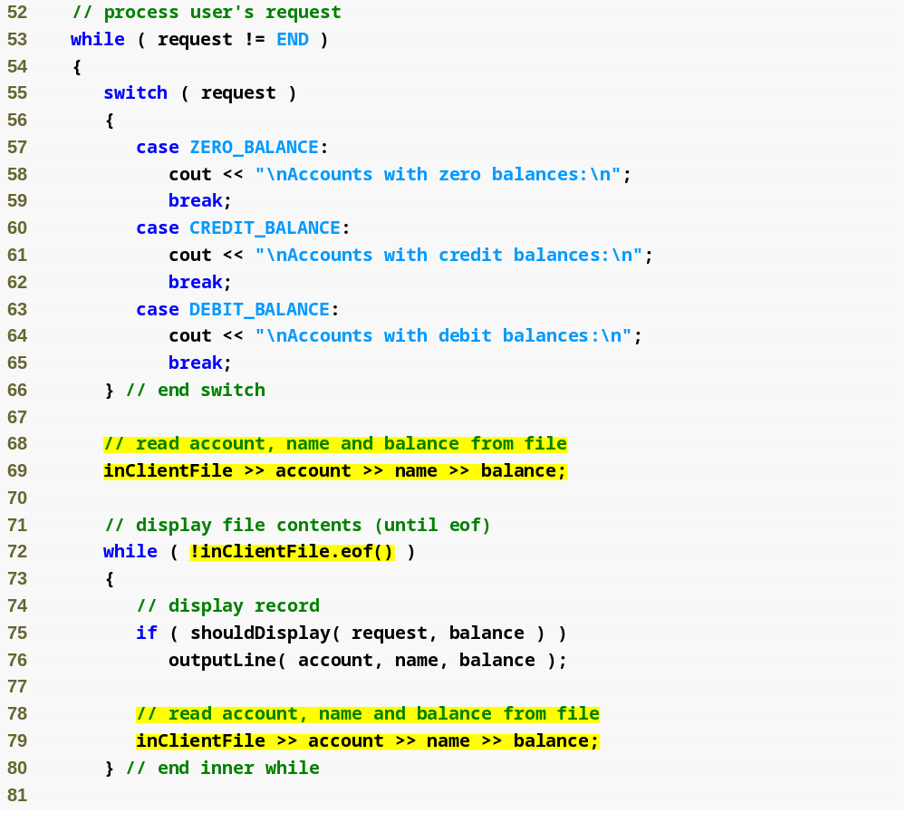
Outline
Fig17_08.cpp
(3 of 6)

Slide 34
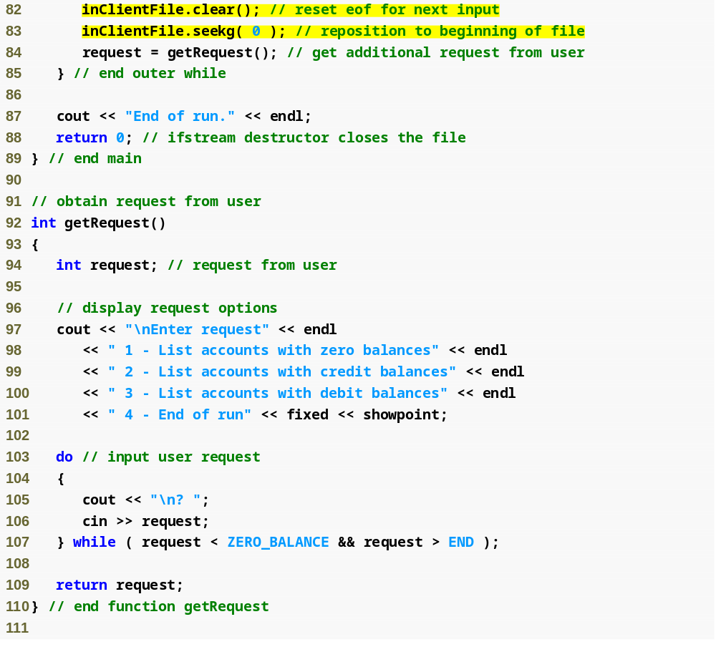
Outline
Use ostream member function seekg to reposition the file-position pointer to the beginning
Fig17_08.cpp
(4 of 6)

Slide 35
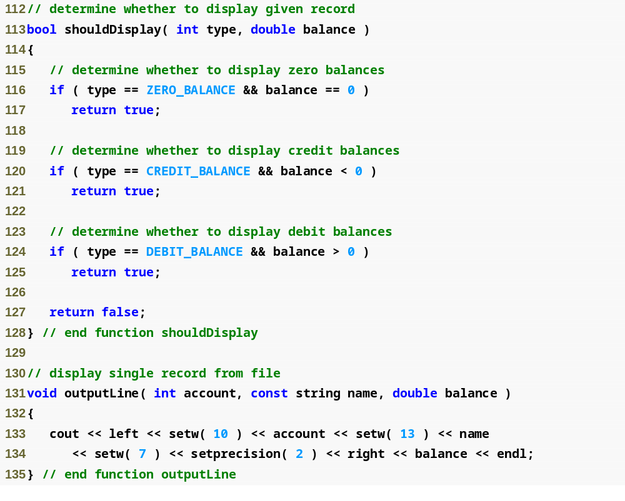
Outline
Fig17_08.cpp
(5 of 6)

Slide 36
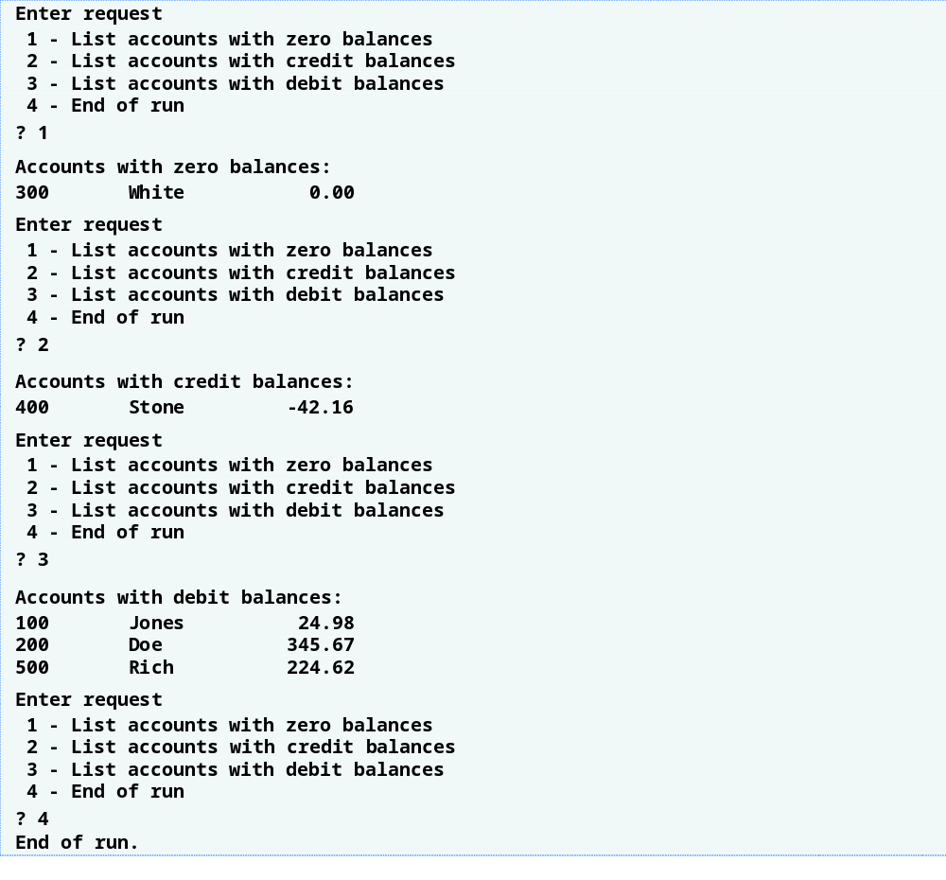
Outline
Fig17_08.cpp
(6 of 6)

Slide 37
17.6 Updating Sequential Files
Updating a record in a sequential file
  The new record could be longer than the old record
    If it is, it could overwrite the next sequential record
    You would have to rewrite every record into another file
      Copy over all records before this one
      Write new version of this record
      Copy over all records after this one
    This might be acceptable if you are updating many records

Slide 38
17.7 Random-Access Files
Random-access files
  Necessary for instant-access applications
    Such as transaction-processing systems
  A record can be inserted, deleted or modified without affecting other records
  Various techniques can be used
    Require that all records be of the same length, arranged in the order of the record keys
      Program can calculate the exact location of any record
        Base on the record size and record key

Slide 39
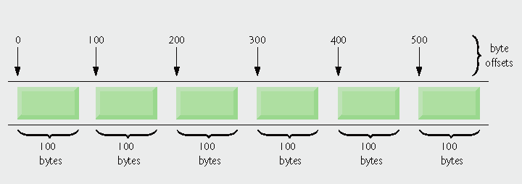
Fig. 17.9 | C++ view of a random-access file.

Slide 40
17.8 Creating a Random-Access File
ostream member function write
  Writes a number of bytes from a location in memory to the stream
    If the stream is associated with a file, the writing is at the “put” file-position pointer
  First argument
    A const char * pointing to bytes in memory
  Second argument
    A size_t specifying the number of bytes to write
  Example
    outFile.write(
    reinterpret_cast<const char *>( &number ), sizeof( number ) );

Slide 41
17.8 Creating a Random-Access File (Cont.)
Operator reinterpret_cast
  Casts a pointer of one type to an unrelated type
  Also converts between pointer and integer types
  Is performed at compile time
    Does not change the value of the object pointed to

Slide 42
Error-Prevention Tip 17.1
It is easy to use reinterpret_cast to perform dangerous manipulations that could lead to serious execution-time errors.

Slide 43
Portability Tip 17.1
Using reinterpret_cast is compiler-dependent and can cause programs to behave differently on different platforms. The reinterpret_cast operator should not be used unless absolutely necessary.

Slide 44
Portability Tip 17.2
A program that reads unformatted data (written by write) must be compiled and executed on a system compatible with the program that wrote the data, because different systems may represent internal data differently.

Slide 45
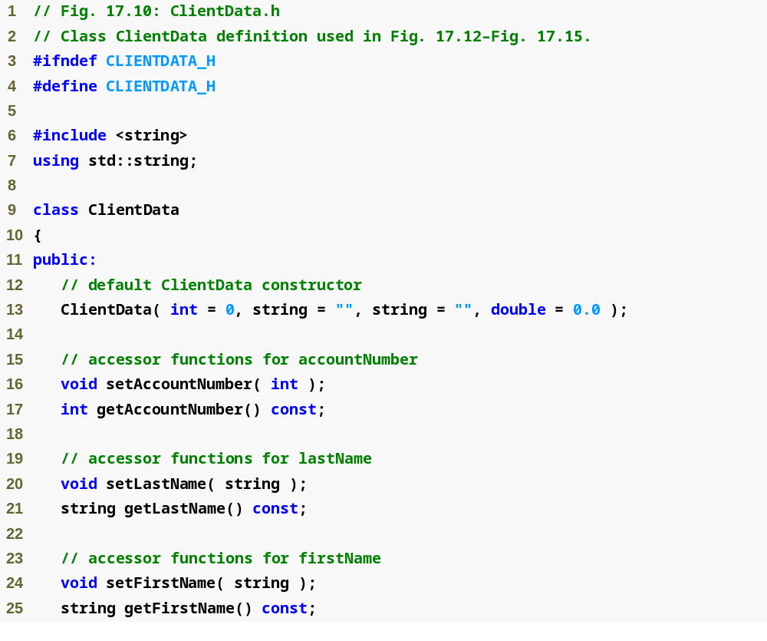
Outline
ClientData.h
(1 of 2)

Slide 46
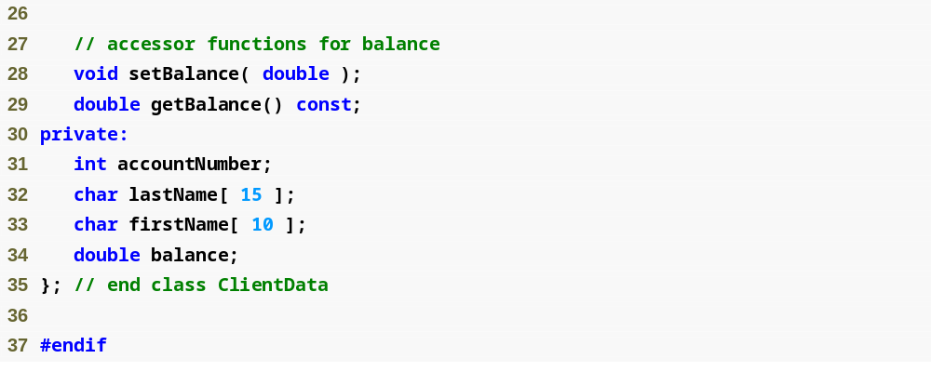
Outline
ClientData.h
(2 of 2)
Store the first and last name in fixed-length char arrays – we cannot use strings because they do not have uniform length

Slide 47
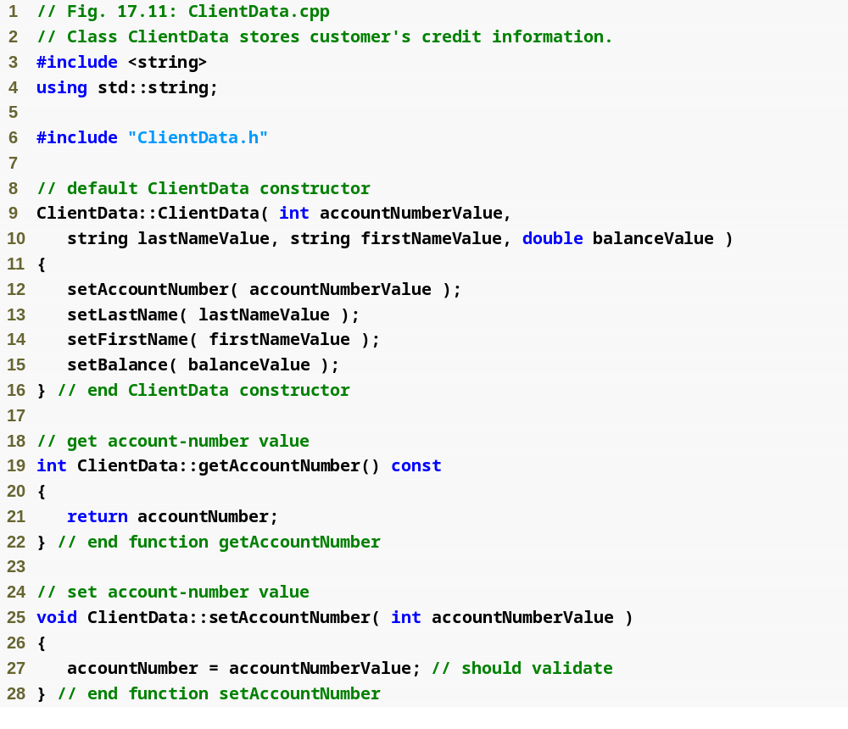
Outline
ClientData.cpp
(1 of 3)

Slide 48
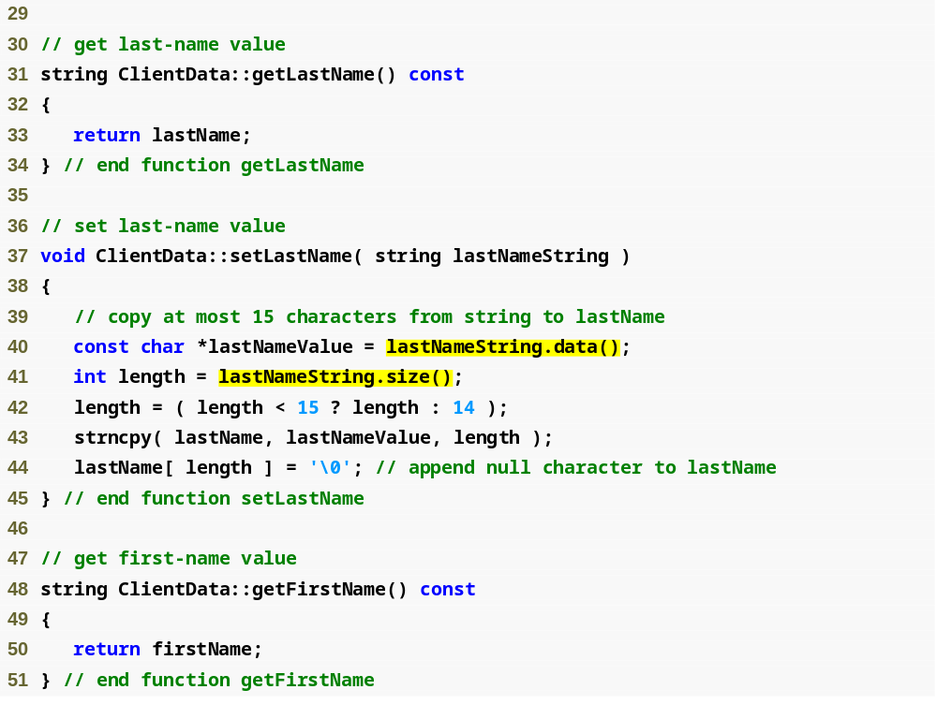
Outline
ClientData.cpp
(2 of 3)
string member function data returns an array containing the characters of the string (not guaranteed to be null terminated)
string member function size returns the length of lastNameString

Slide 49
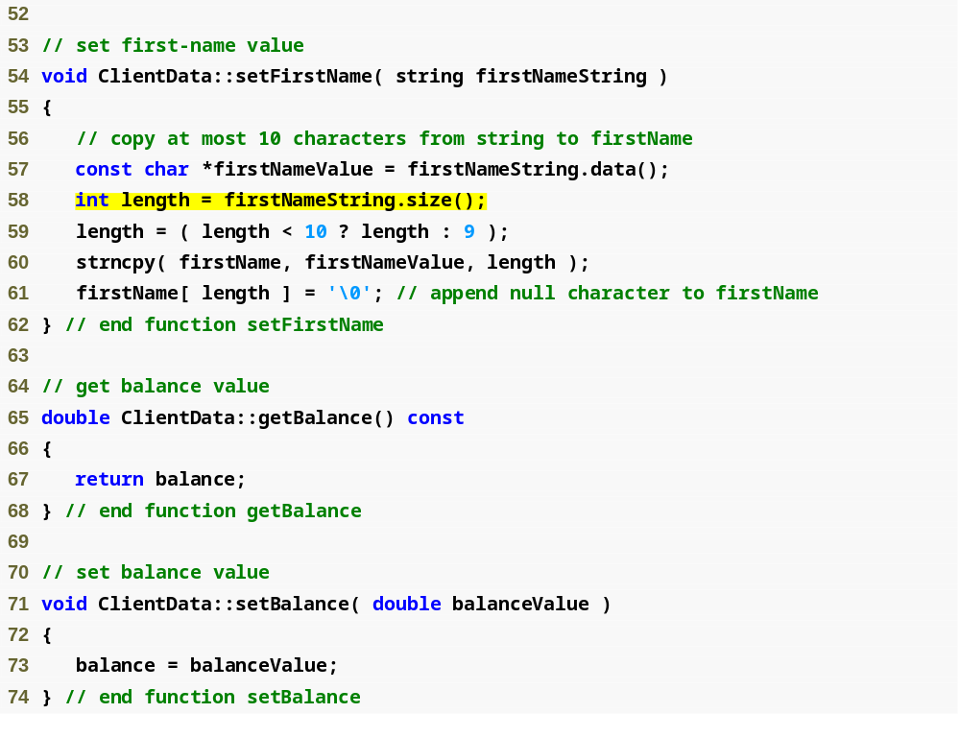
Outline
ClientData.cpp
(3 of 3)

Slide 50
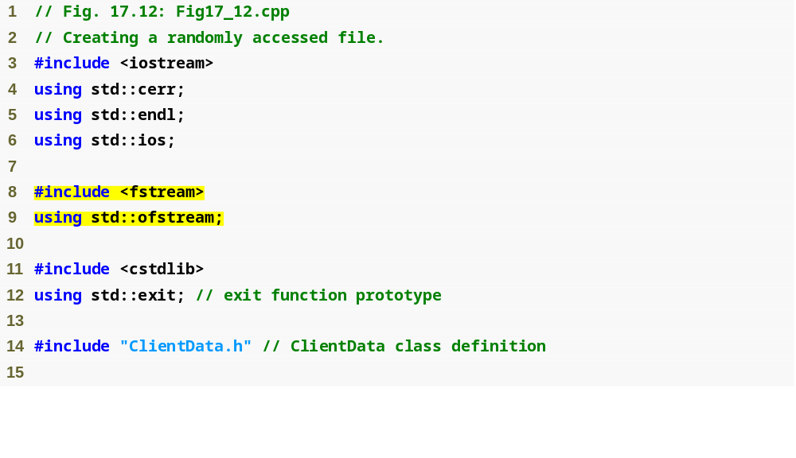
Outline
Fig17_12.cpp
(1 of 2)

Slide 51
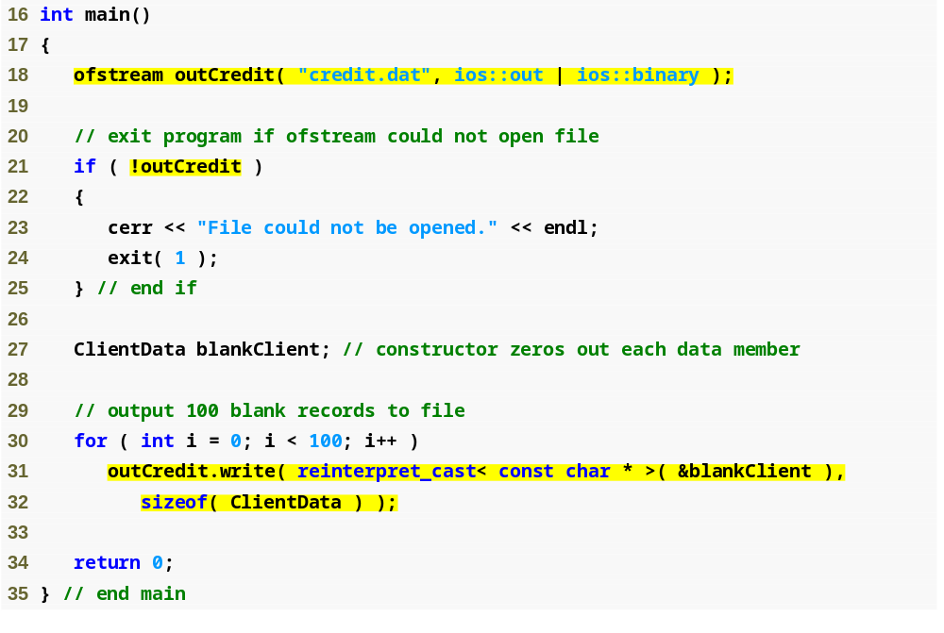
Outline
Open credit.dat in binary mode, which is required to write fixed-length records
Fig17_12.cpp
(2 of 2)
Write the data in blankClient to credit.dat as bytes

Slide 52
17.9 Writing Data Randomly to a Random-Access File
Writing data randomly
  Opening for input and output in binary mode
    Use an fstream object
    Combine file-open modes ios::in, ios::out and ios::binary
      Separate each open mode from the next with the bitwise inclusive OR operator (|)
  Use function seekp to set the “put” file-position pointer to the specific position
    Example calculation
      ( n – 1 ) * sizeof( ClientData )
        Byte location for nth ClientData record
  Use function write to output the data

Slide 53
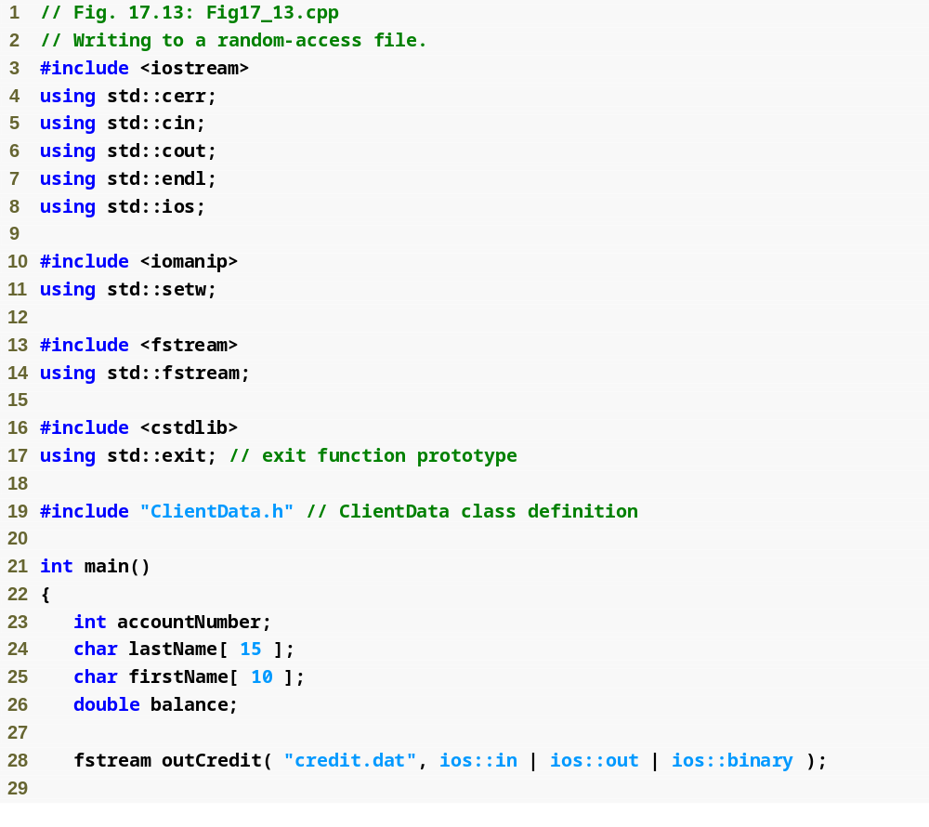
Outline
Fig17_13.cpp
(1 of 4)
Create fstream outCredit to open credit.dat for input and output in binary mode

Slide 54
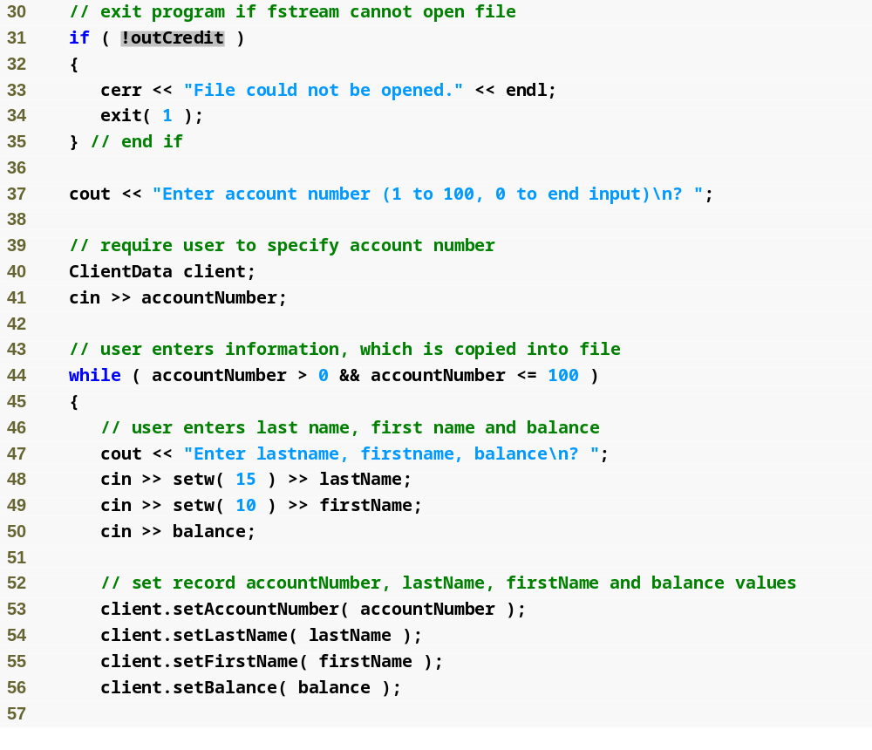
Outline
Fig17_13.cpp
(2 of 4)

Slide 55
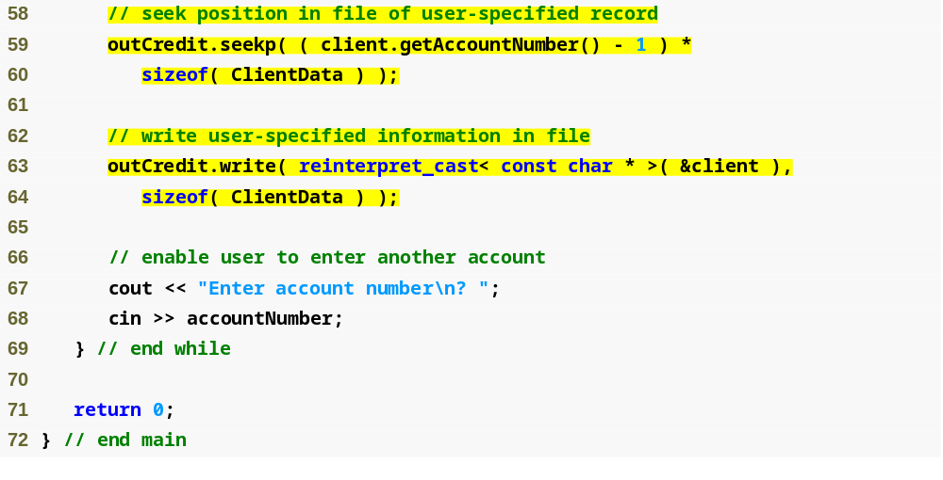
Outline
Position the “put” file-position pointer to the desired byte location
Fig17_13.cpp
(3 of 4)
Write the ClientData record to the correct position in the file

Slide 56
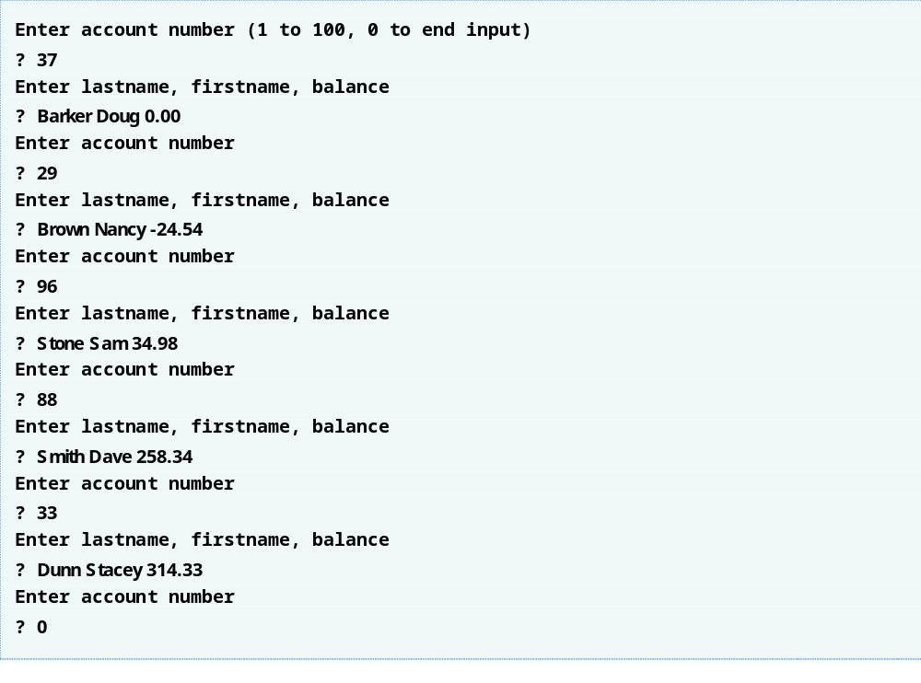
Outline
Fig17_13.cpp
(4 of 4)

Slide 57
17.10 Reading from a Random-Access File Sequentially
Sequentially reading a random-access file
  Ifstream member function read
    Inputs a number of bytes from the current file position in the stream into an object
    First argument
      A char * pointing to the object in memory
    Second argument
      A size_t specifying the number of bytes to input
  Additional benefit
    Sequentially read-in records are sorted in order of ascending record keys
      Space-time trade off: a fast sorting algorithm, but space-consuming

Slide 58
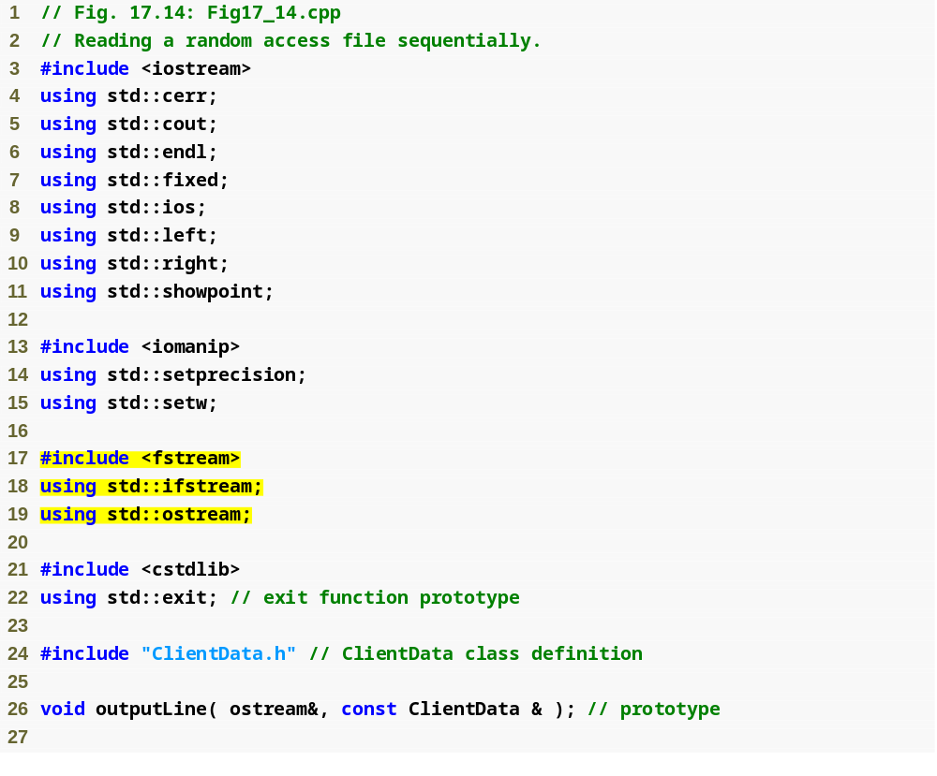
Outline
Fig17_14.cpp
(1 of 3)

Slide 59
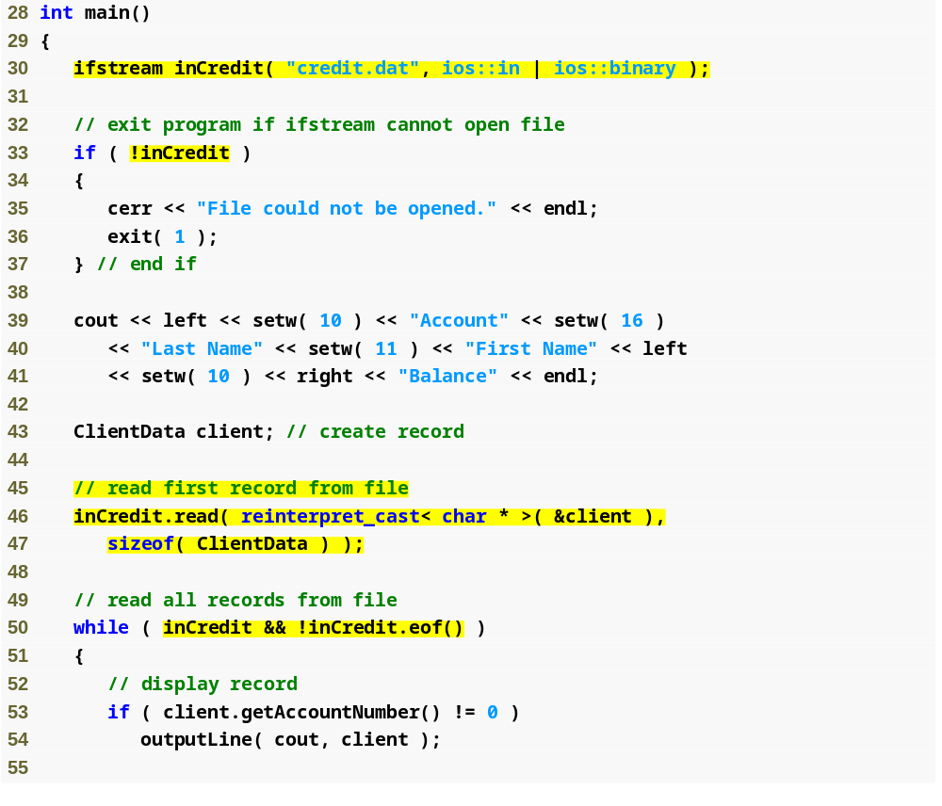
Outline
Fig17_14.cpp
(2 of 3)
This loop-continuation condition evaluates to false if an error occurs when reading from the file or if the end of file is reached

Slide 60
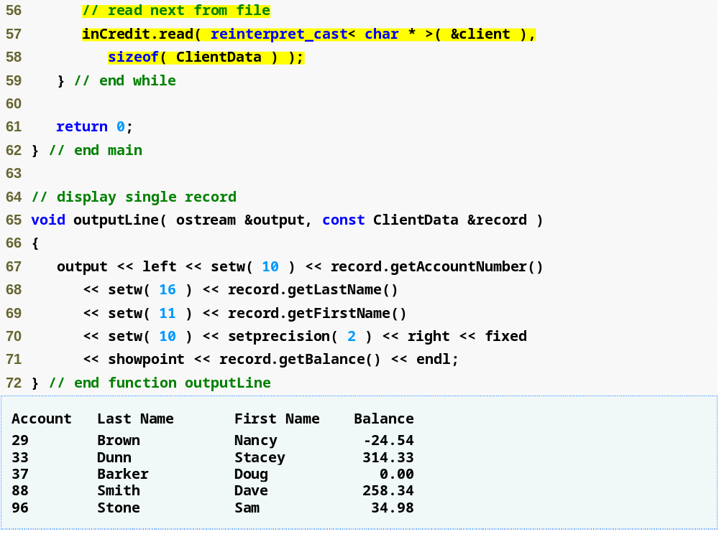
Outline
Because outputLine takes an ostream reference as argument, it can be used with cout (an ostream object) or an ofstream object (derived from ostream) to output to the screen or to a file
Fig17_14.cpp
(3 of 3)

Slide 61
17.11 Case Study: A Transaction-Processing Program

Slide 62
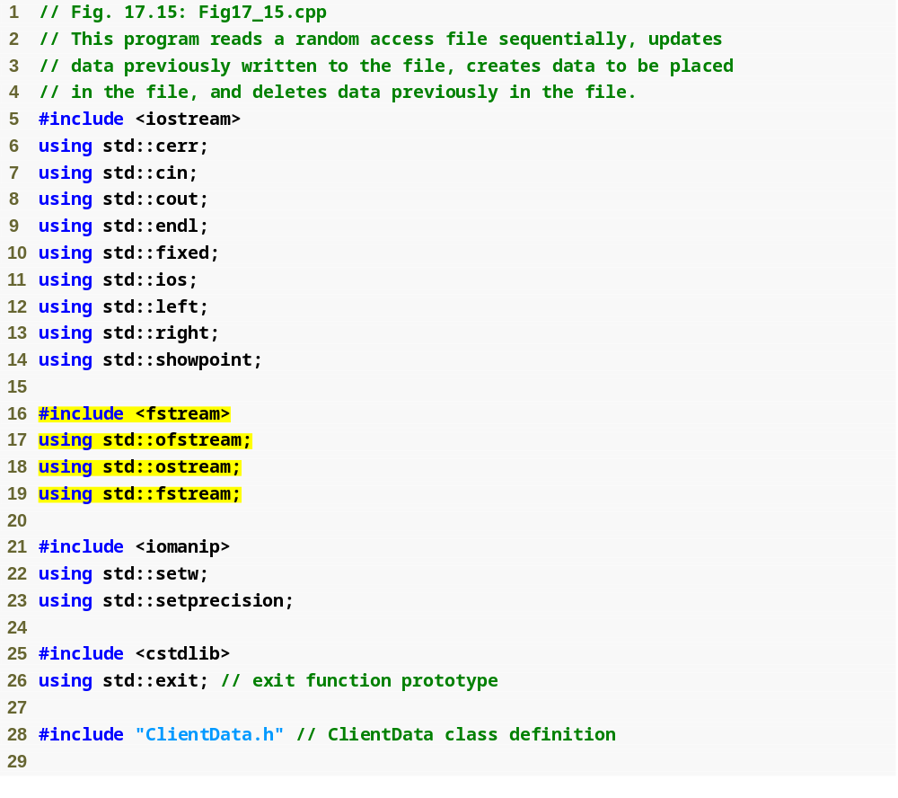
Outline
Fig17_15.cpp
(1 of 10)

Slide 63
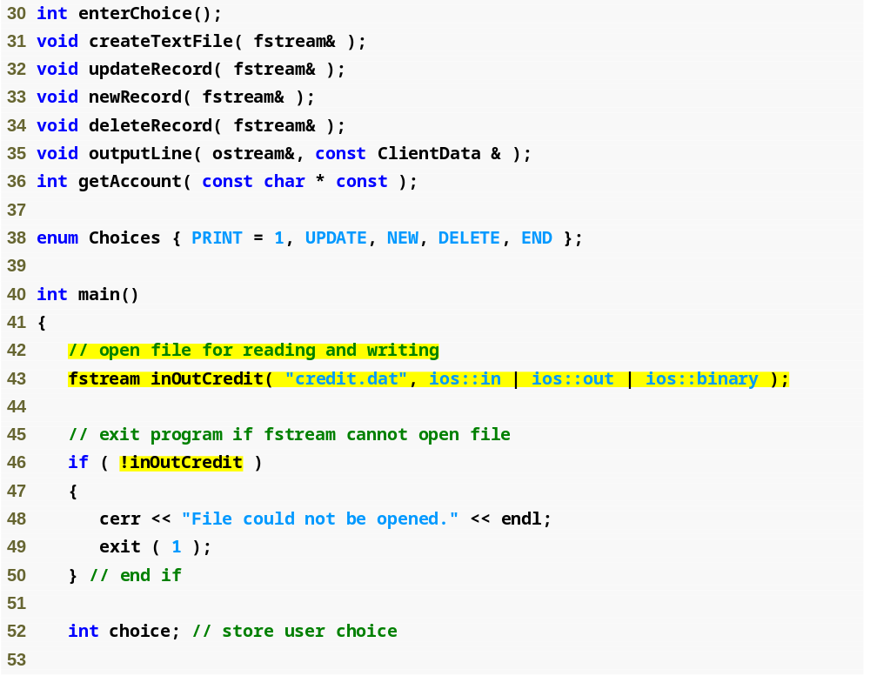
Outline
Fig17_15.cpp
(2 of 10)
“Or” together modes ios::in and ios::out for both reading and writing capabilities

Slide 64
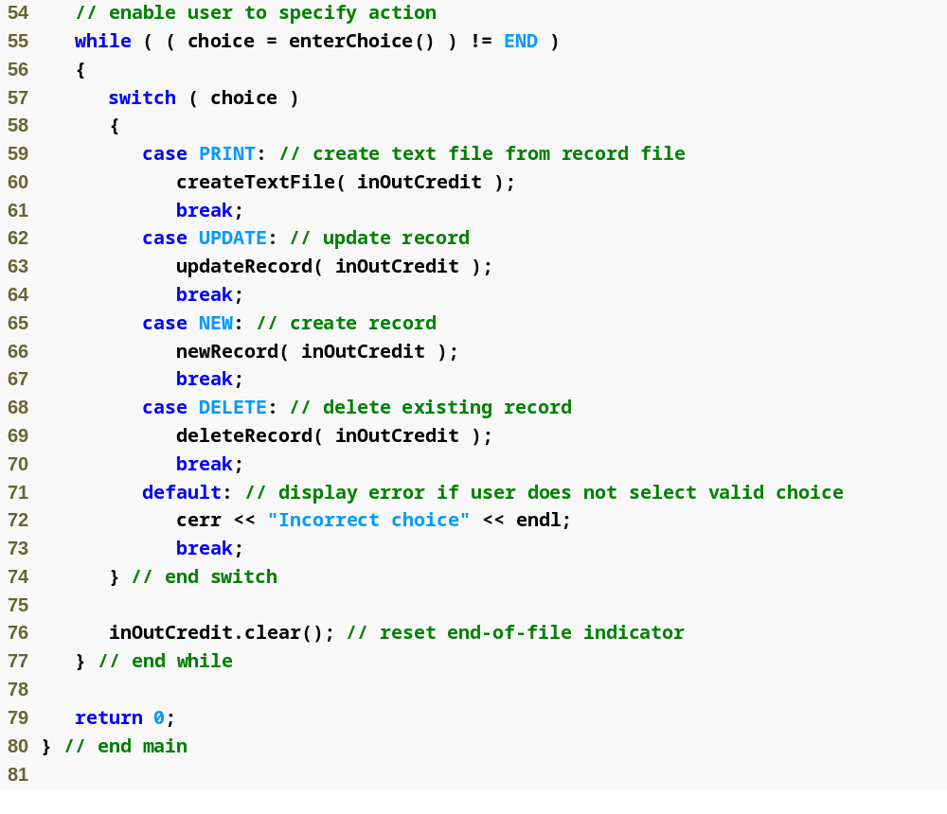
Outline
Fig17_15.cpp
(3 of 10)

Slide 65
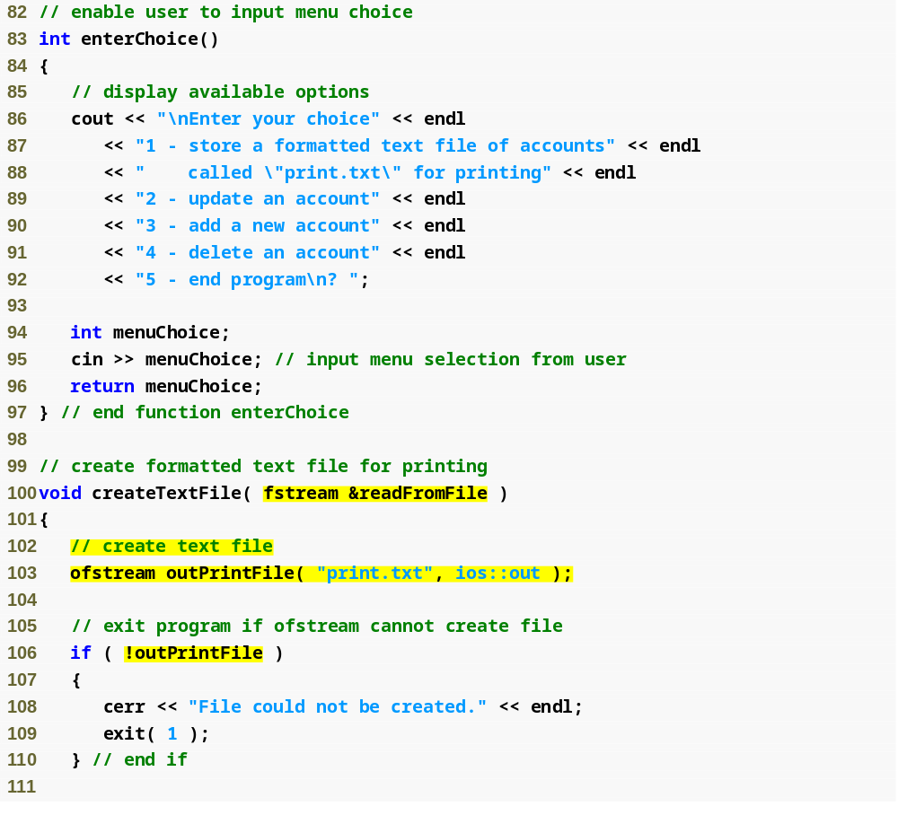
Outline
Fig17_15.cpp
(4 of 10)
fstream object argument for inputting data from credit.dat

Slide 66
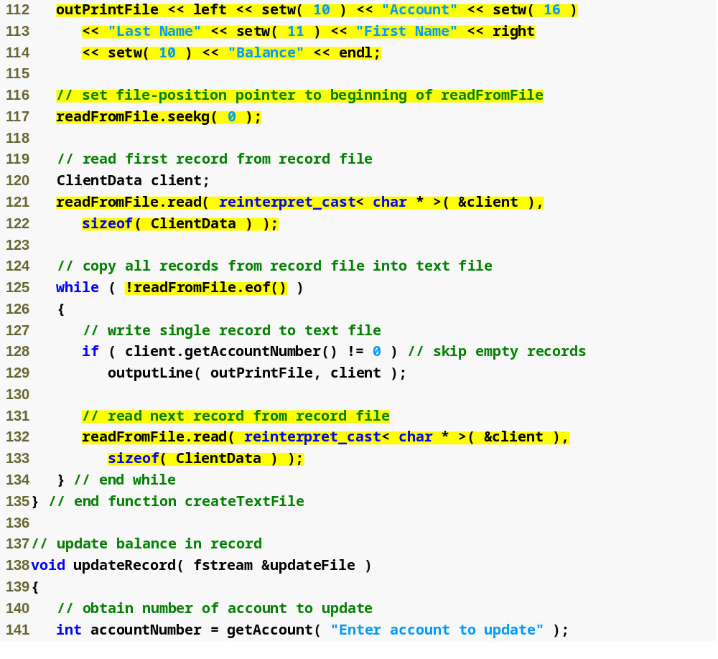
Outline
Use istream member function seekg to ensure that the file-position pointer is at the beginning of the file
Fig17_15.cpp
(5 of 10)

Slide 67
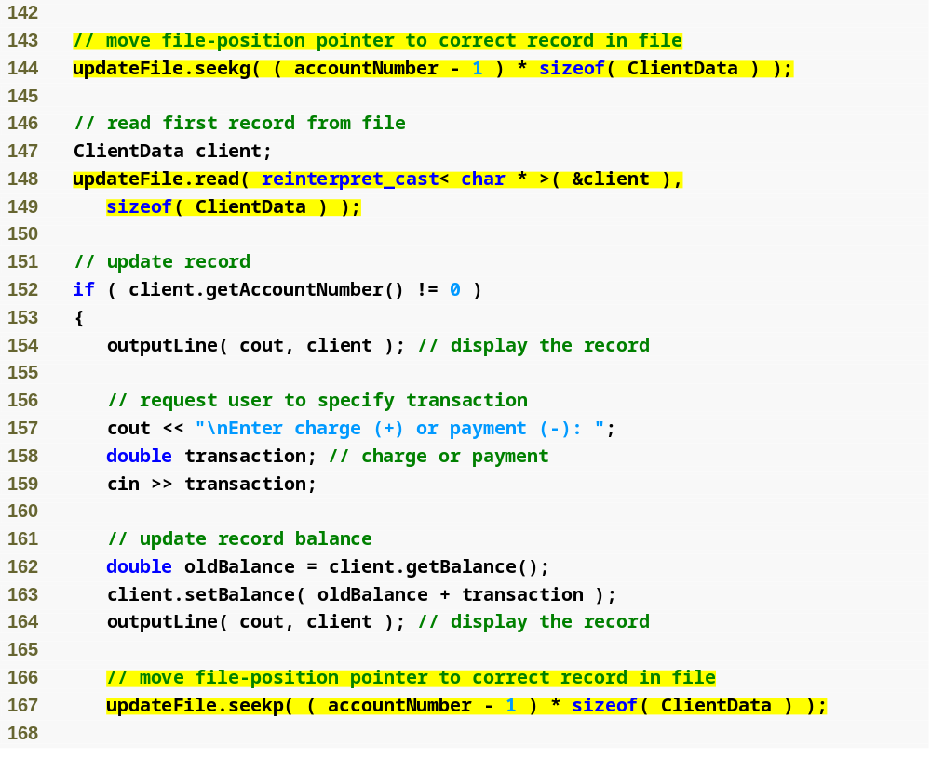
Outline
Fig17_15.cpp
(6 of 10)
Read data into object client, using istream member function read
Determine whether the record contains information
Use function outputLine with the cout ostream object to display the record

Slide 68
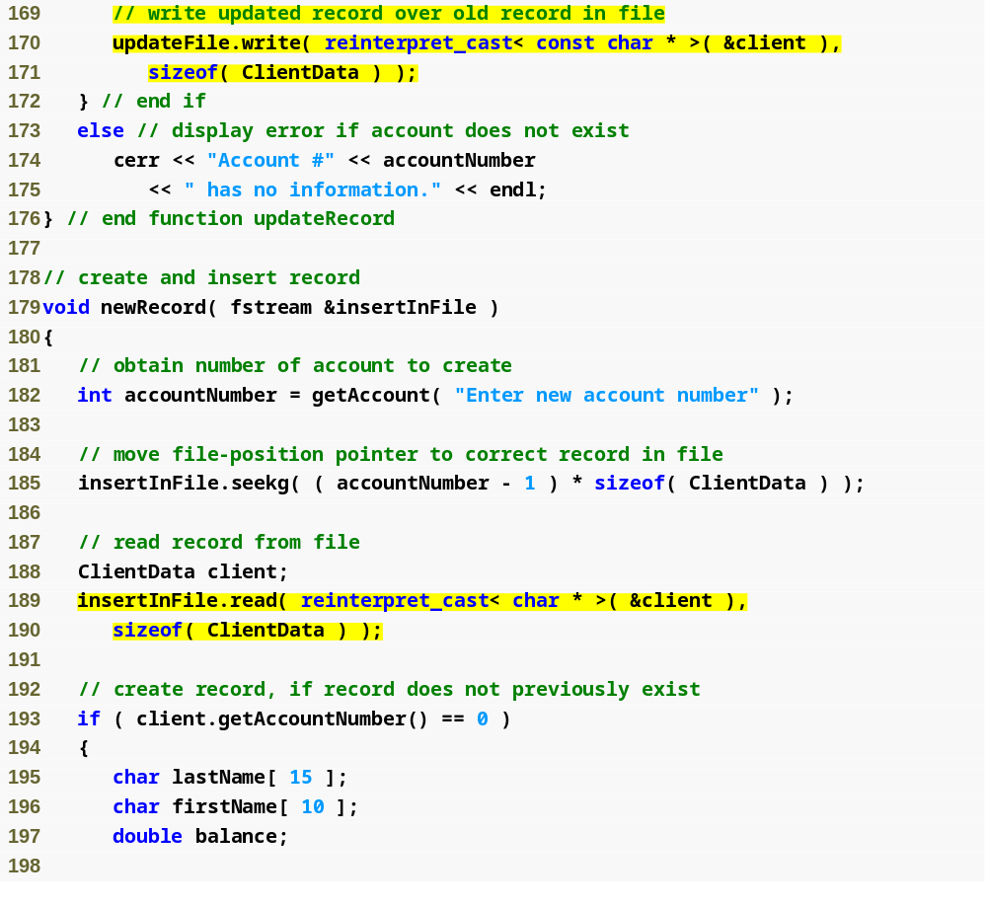
Outline
Fig17_15.cpp
(7 of 10)

Slide 69
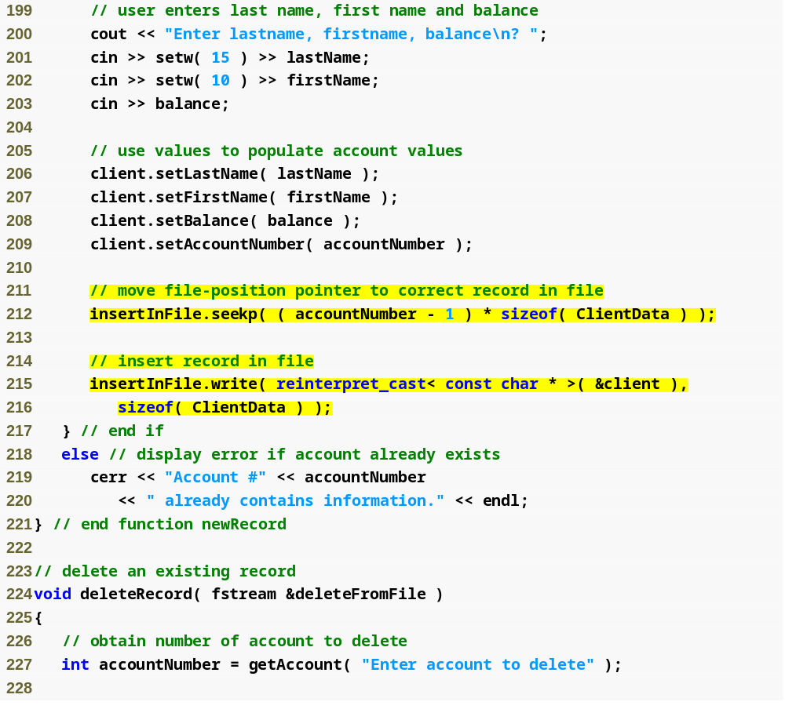
Outline
Fig17_15.cpp
(8 of 10)
Display an error message indicating that the account exists

Slide 70
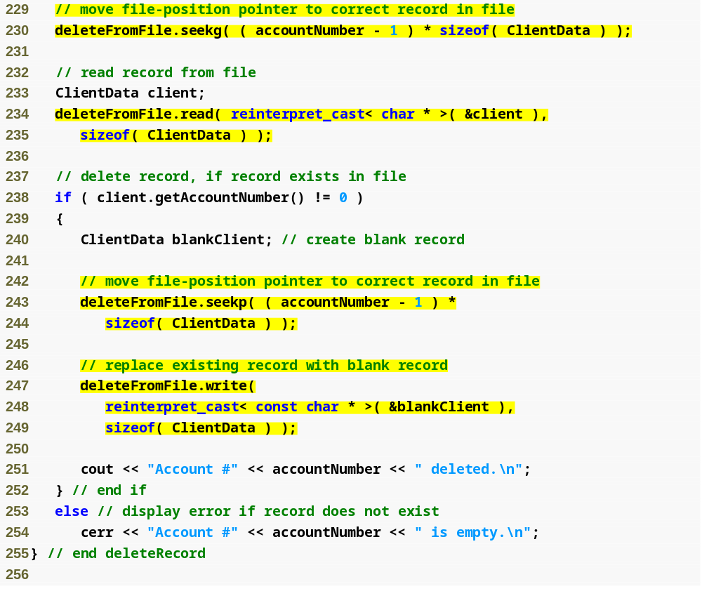
Outline
Fig17_15.cpp
(9 of 10)
Copy an empty record into the file to reinitialize that account
If the specified account is empty, display an error message

Slide 71
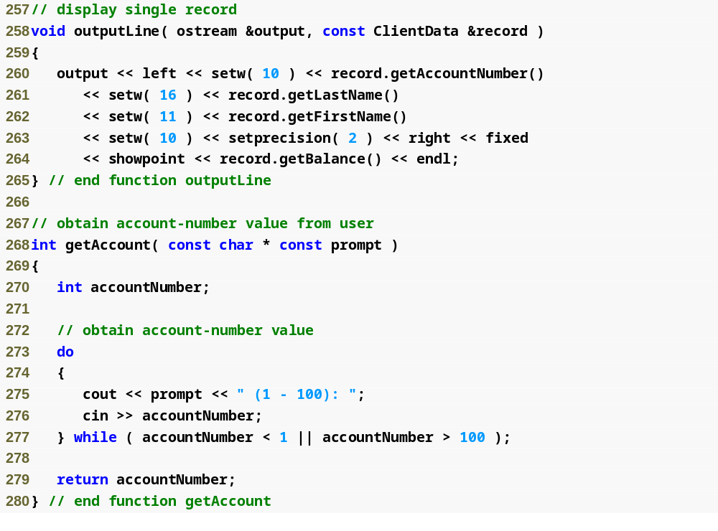
Outline
Fig17_15.cpp
(10 of 10)

Slide 72
17.12 Overview of Object Serialization
When object data members are output to a disk file, we lose the object’s type information
  Store only the values of the object’s attributes, not type information, on the disk
  If the program that reads this data knows the object type to which the data corresponds, the program can read the data into an object of that type

Slide 73
17.12 Overview of Object Serialization
Object serialization
  A serialized object is represented as a sequence of bytes that includes the object’s data as well as information about the object’s type and the types of data stored in the object
  After a serialized object has been written to a file, it can be read from the file and deserialized, the type information and bytes that represent the object and its data can be used to recreate the object in memory.

Slide 74
17.12 Overview of Object Serialization (cont.)
C++ does not provide a built-in serialization mechanism
There are third party and open source C++ libraries that support object serialization.
The open source Boost C++ Libraries provide support for serializing objects in text, binary and extensible markup language (XML) formats (www.boost.org/libs/serialization/doc/index.html).

